Slide 1


Slide 2



MISSIONS
.1
.
1
2
P.A.T.H. SENSORS
SEARCH FOR HABITABLILTY

Slide 3
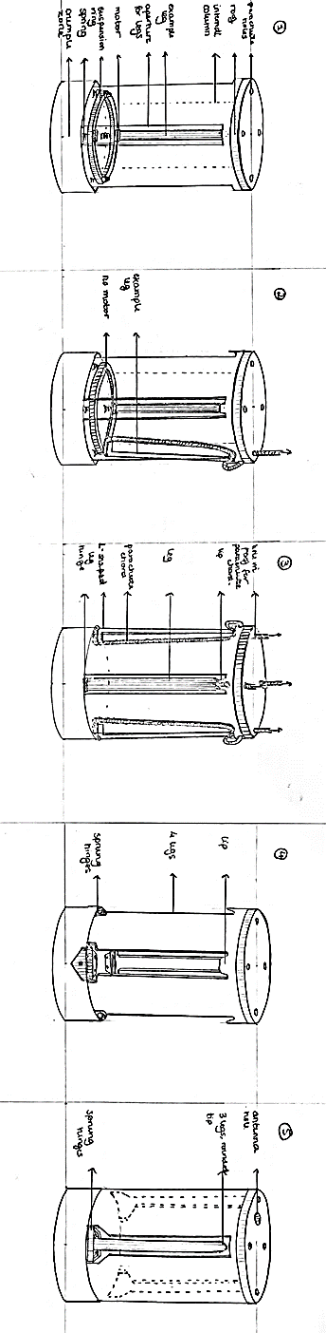
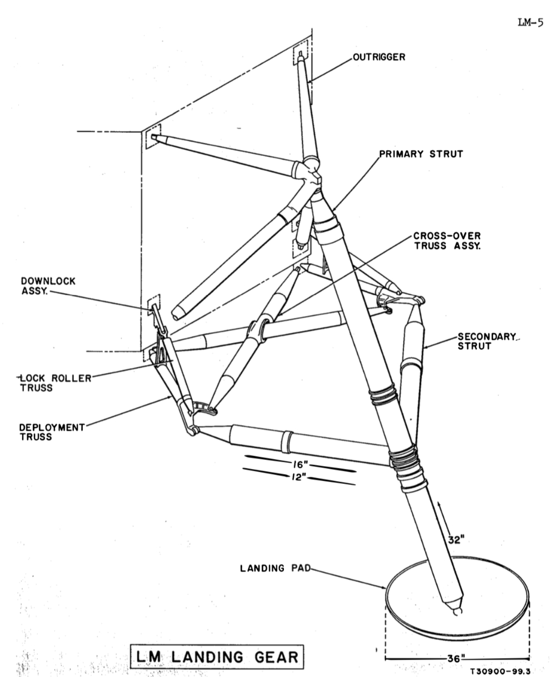
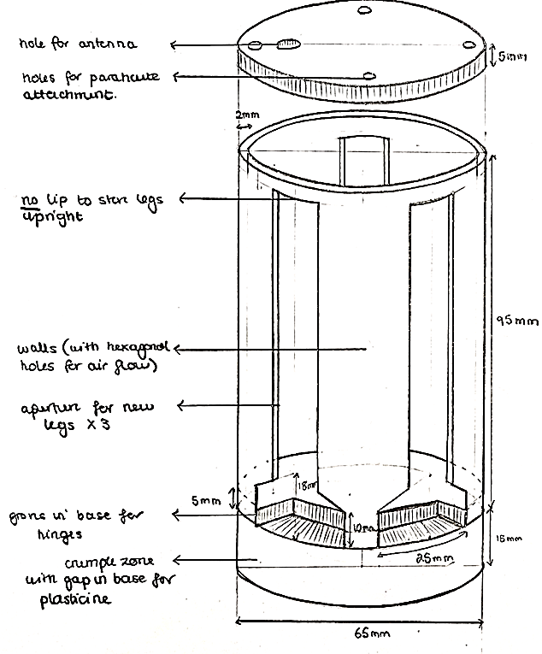
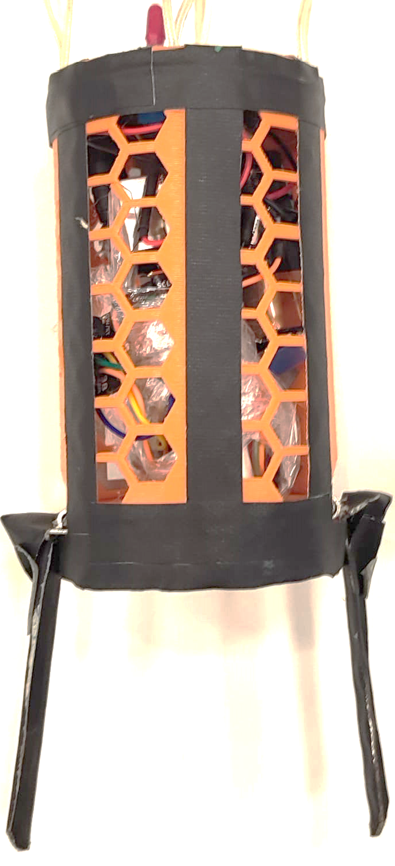
CAN DESIGN
Apollo 11 Lunar Module Landing System

Slide 4
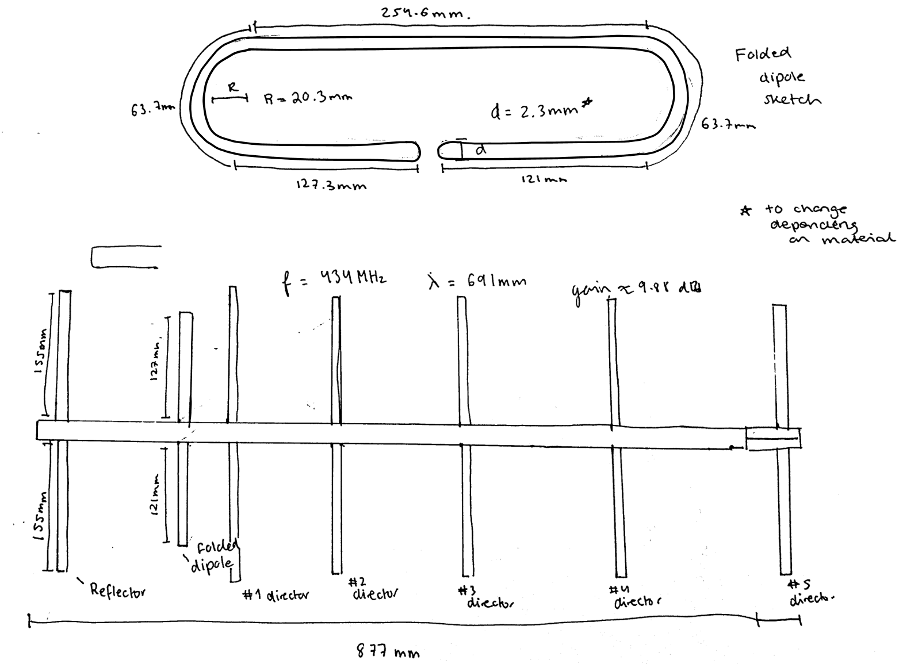
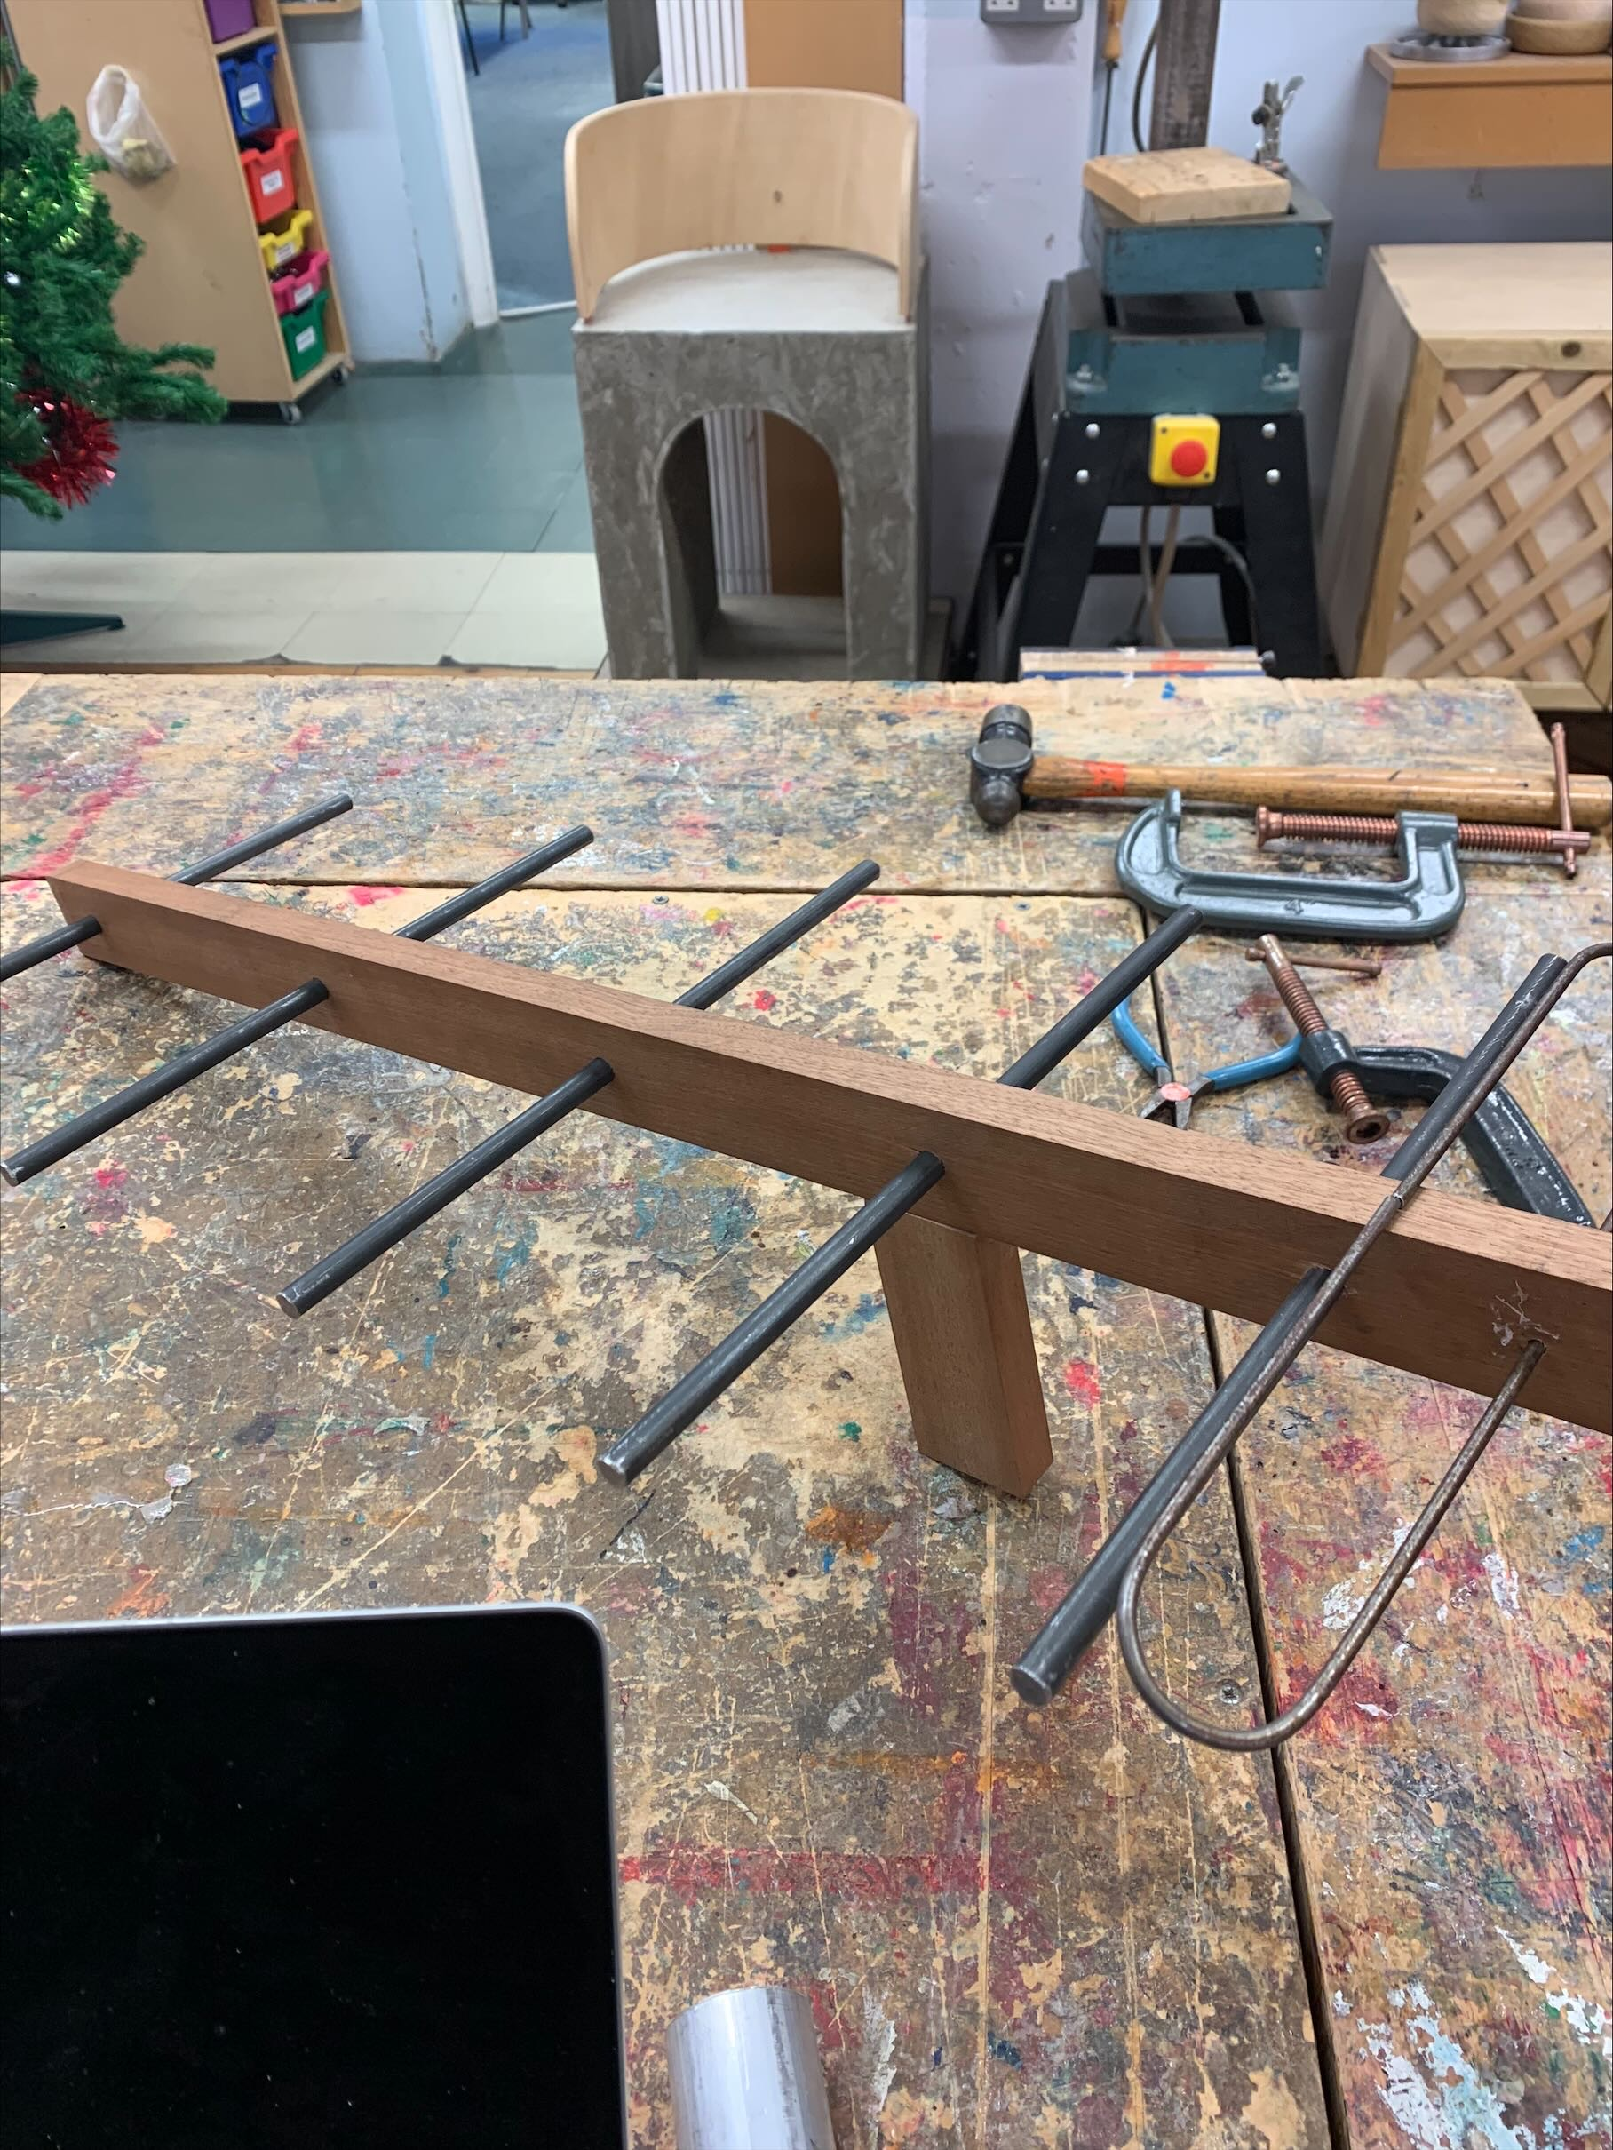
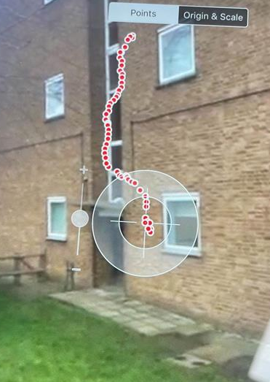
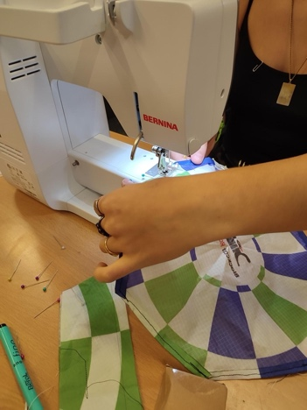
YAGI & PARACHUTE
Notes:
Using a Yagi Calculator, we built the antenna and tuned the measurements to a specific frequency in order to properly amplify our signal. We bought a parachute online but after rigorous testing and calculations, we realized the surface area had to be reduced to increase the final descent rate. At our regional launch, our parachute cords got tangled, stopping it from fully deploying. We made amendments by shortening the length which led to yesterday's successful launch.

Slide 5
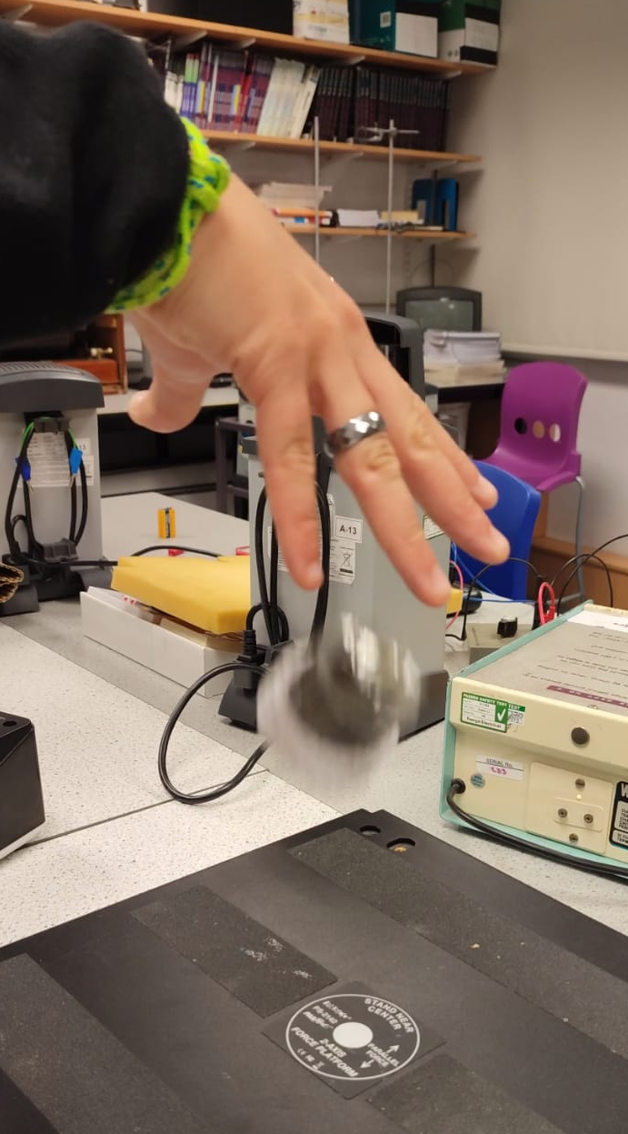
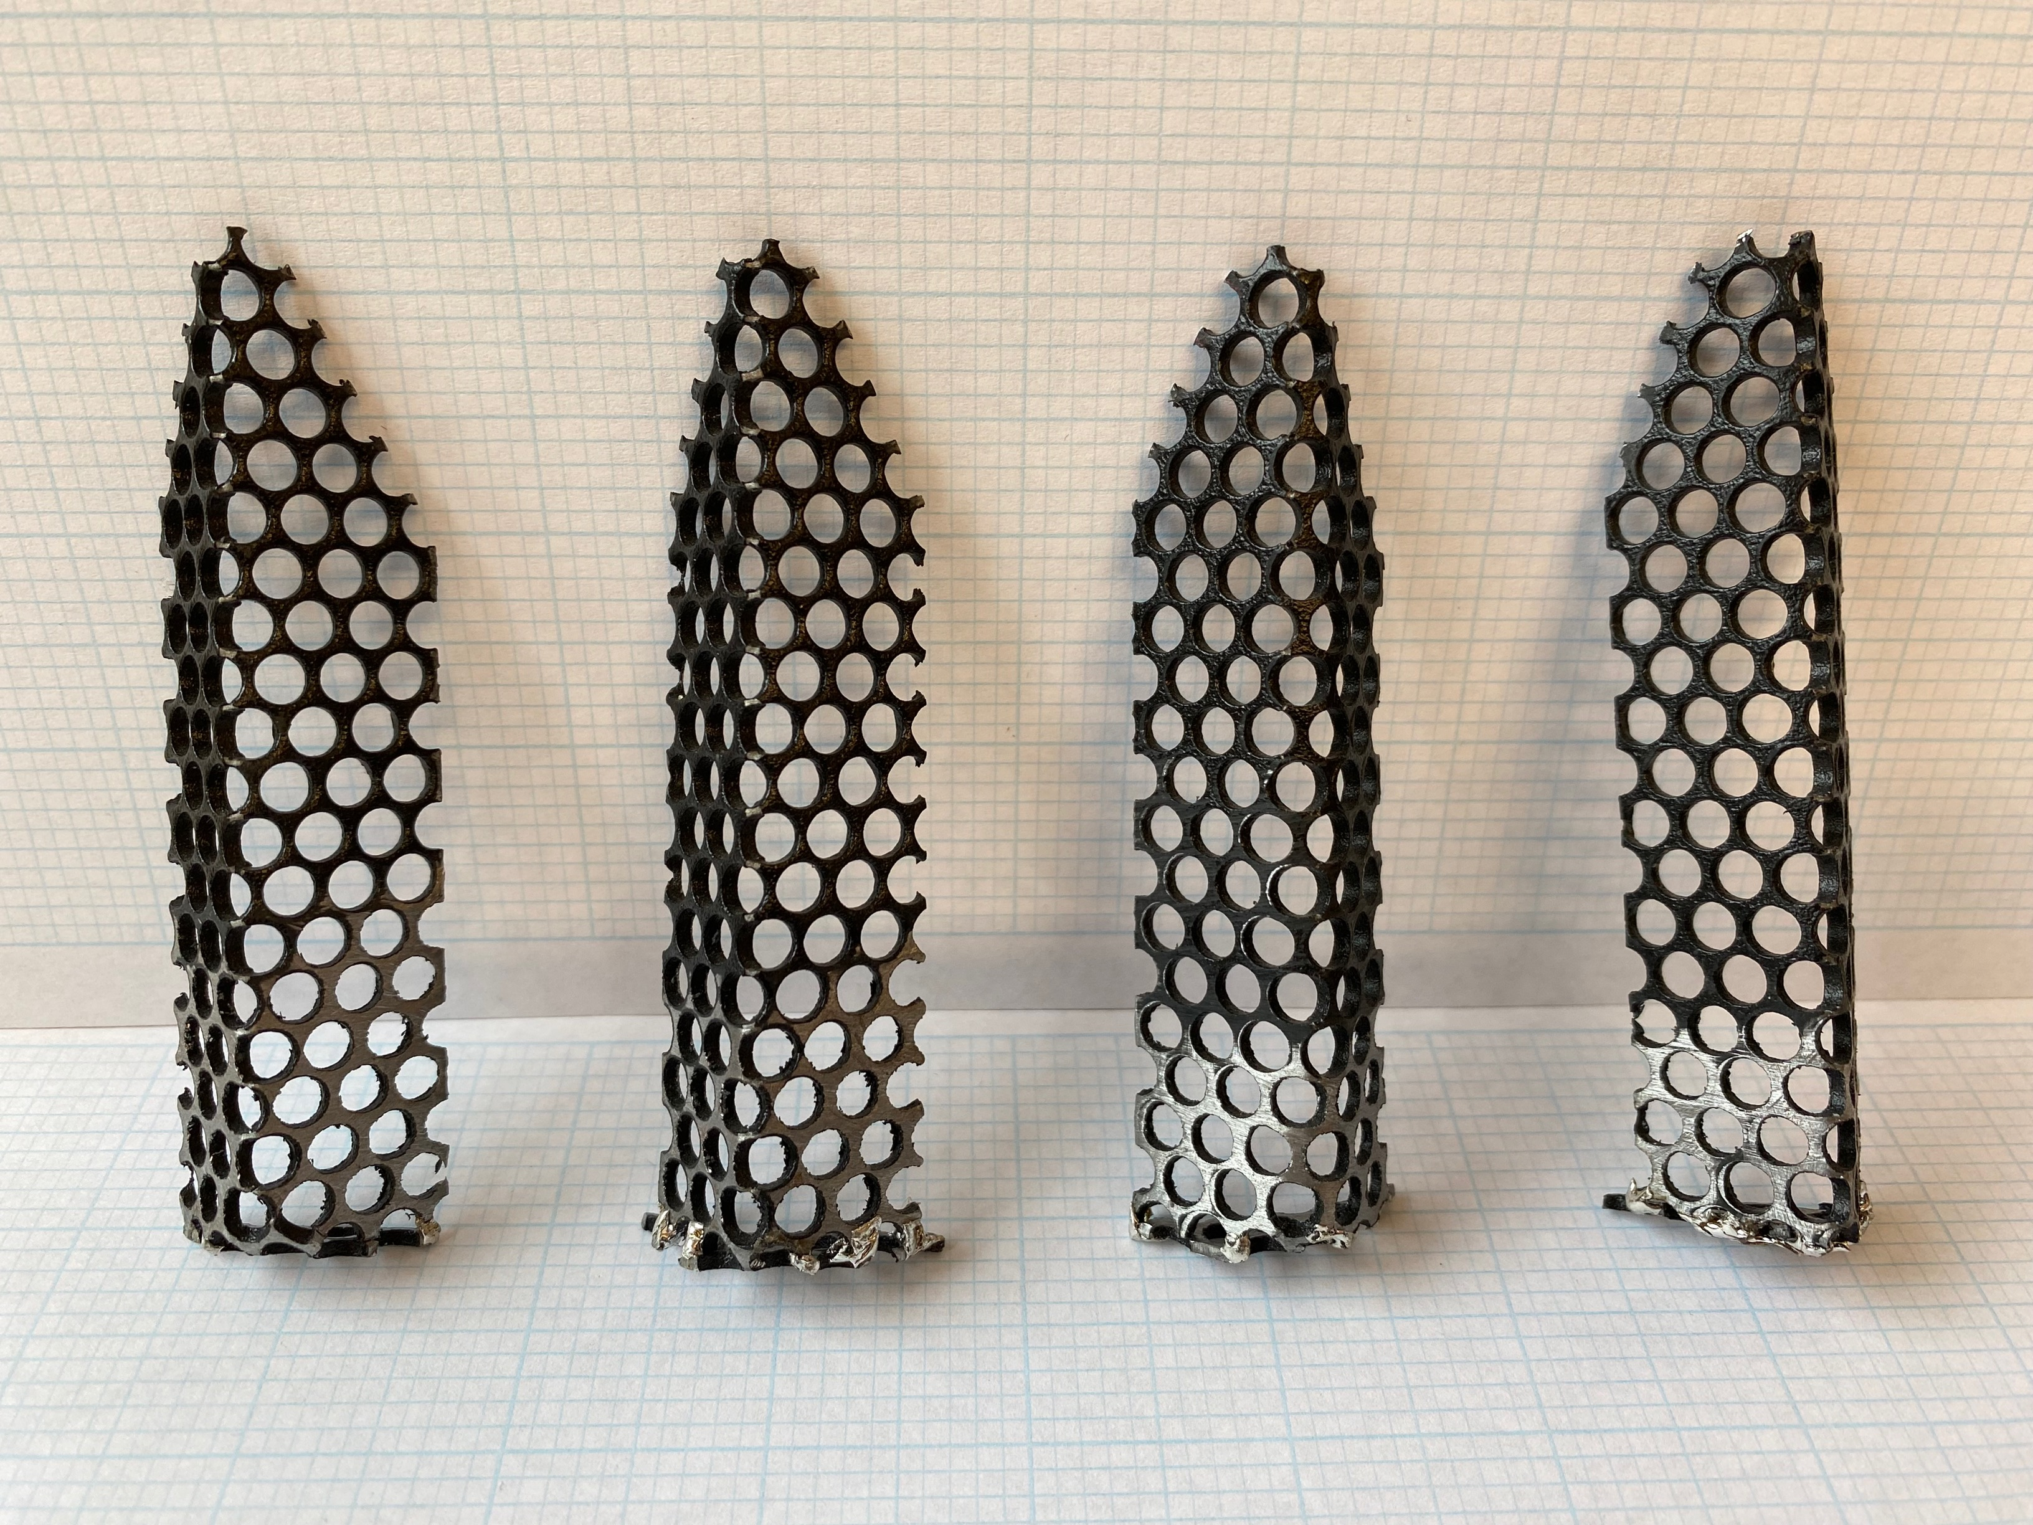
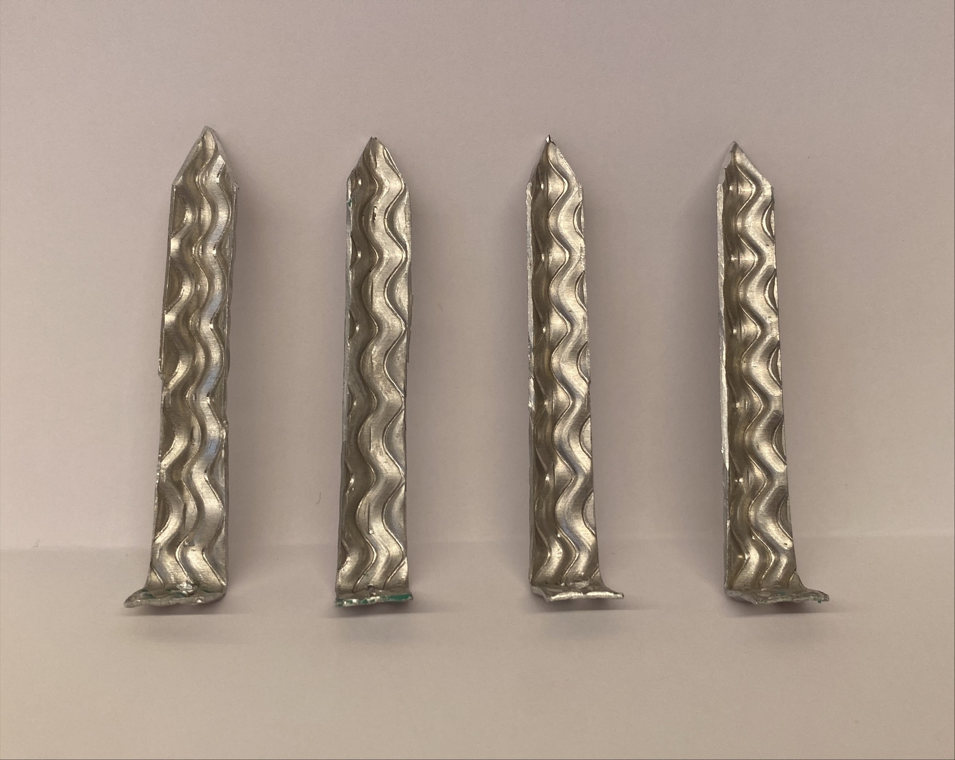
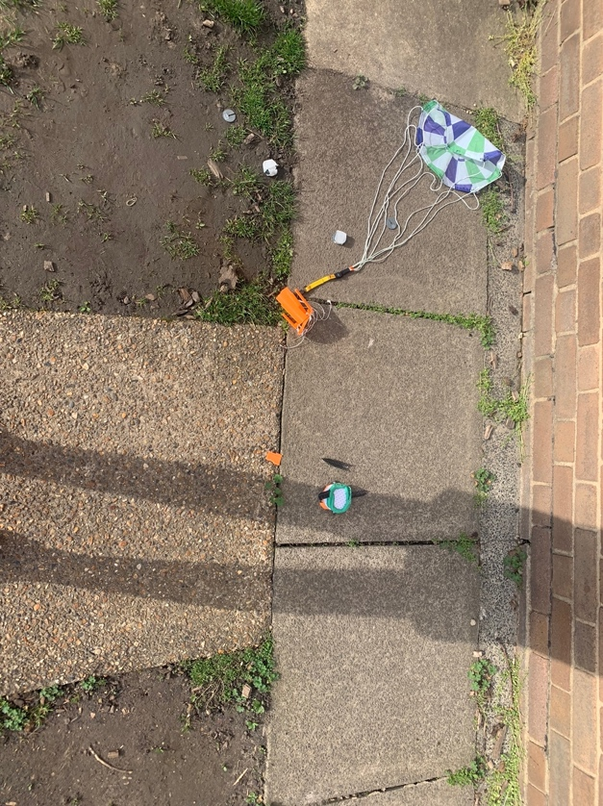
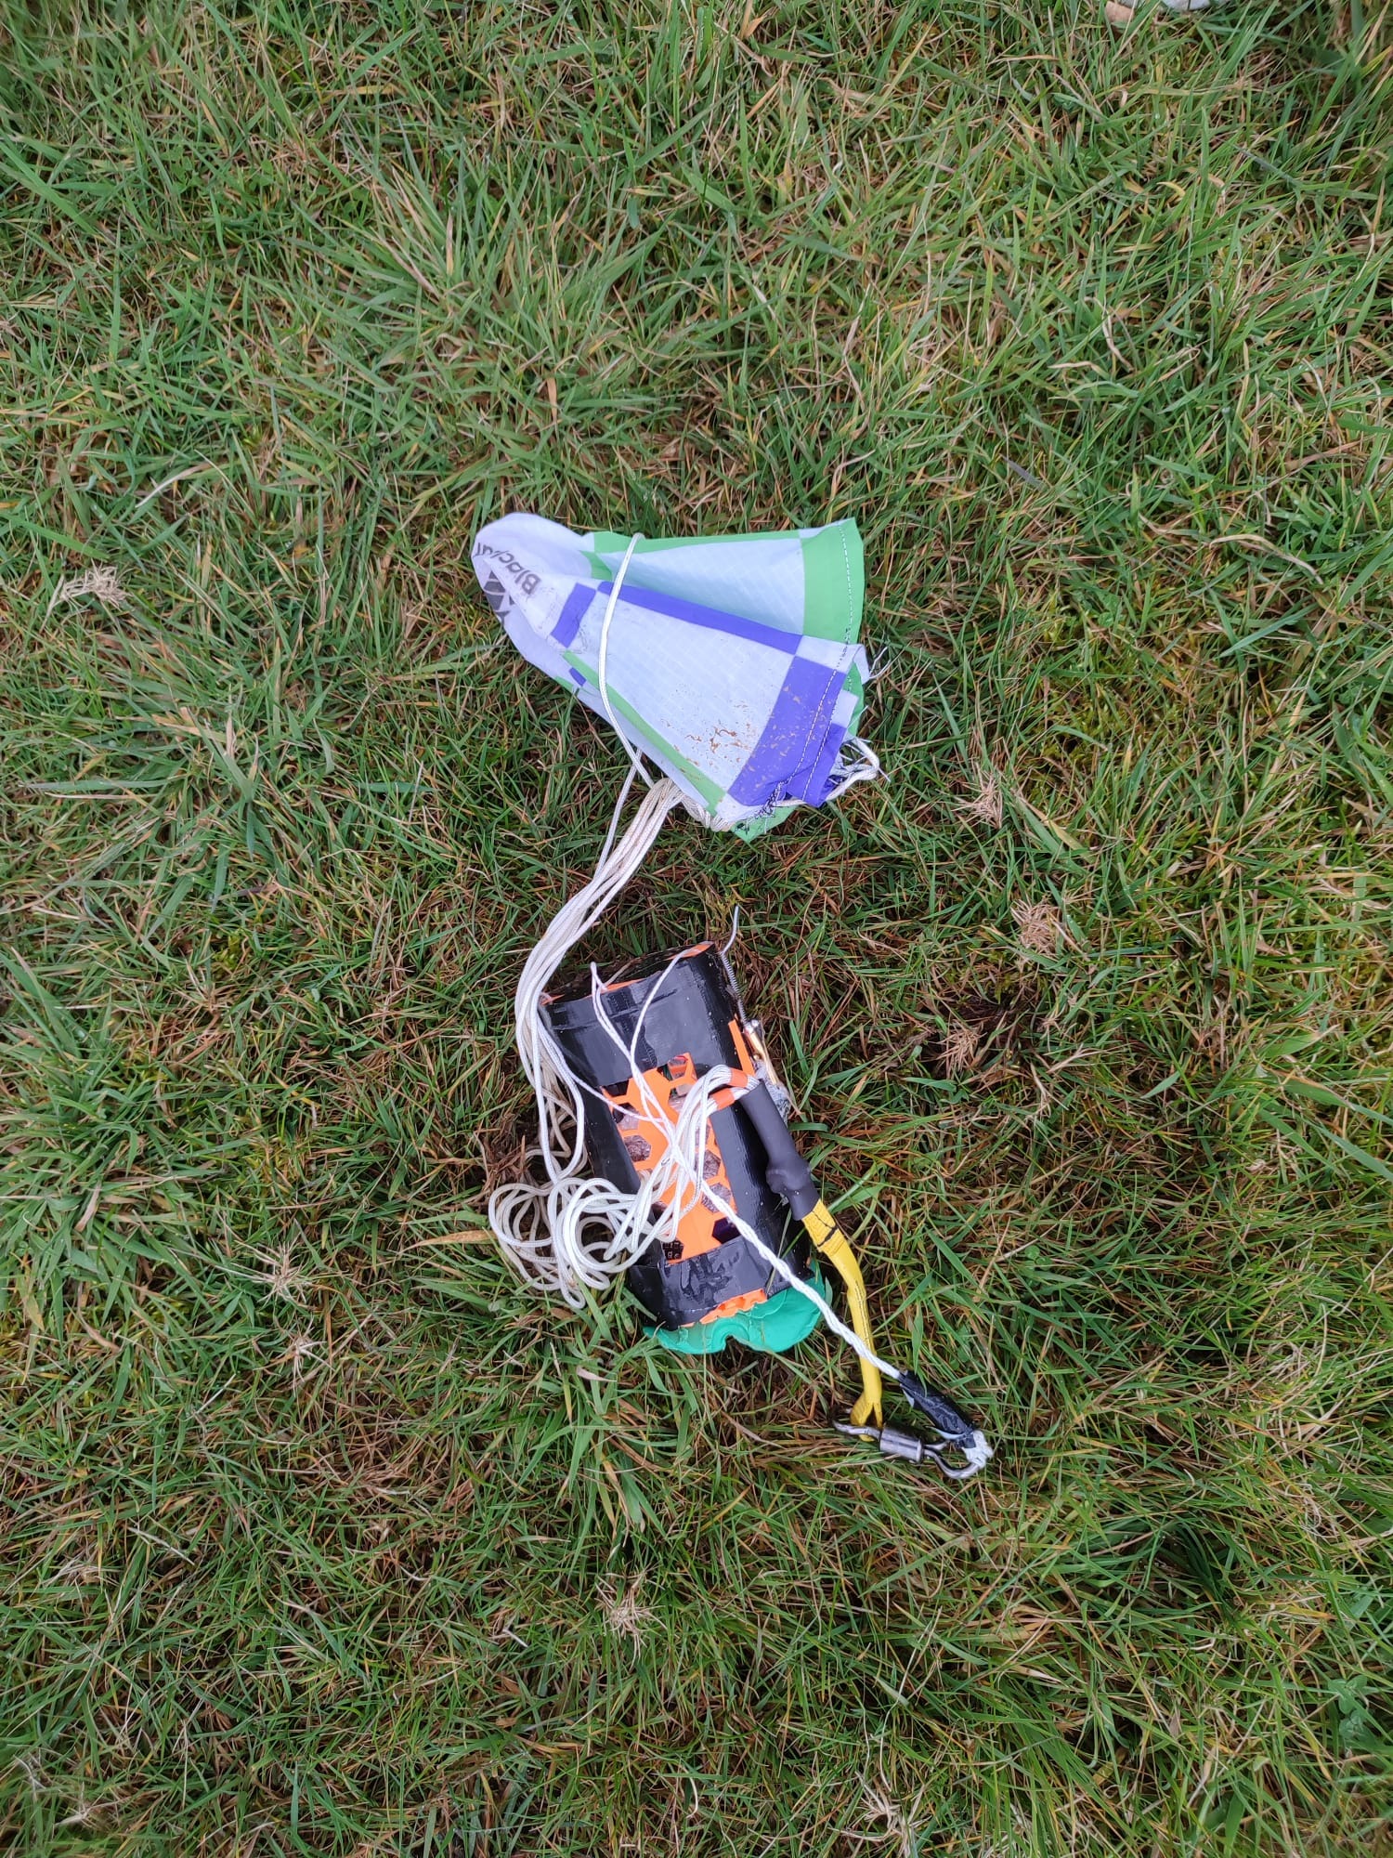
TESTING

Slide 6
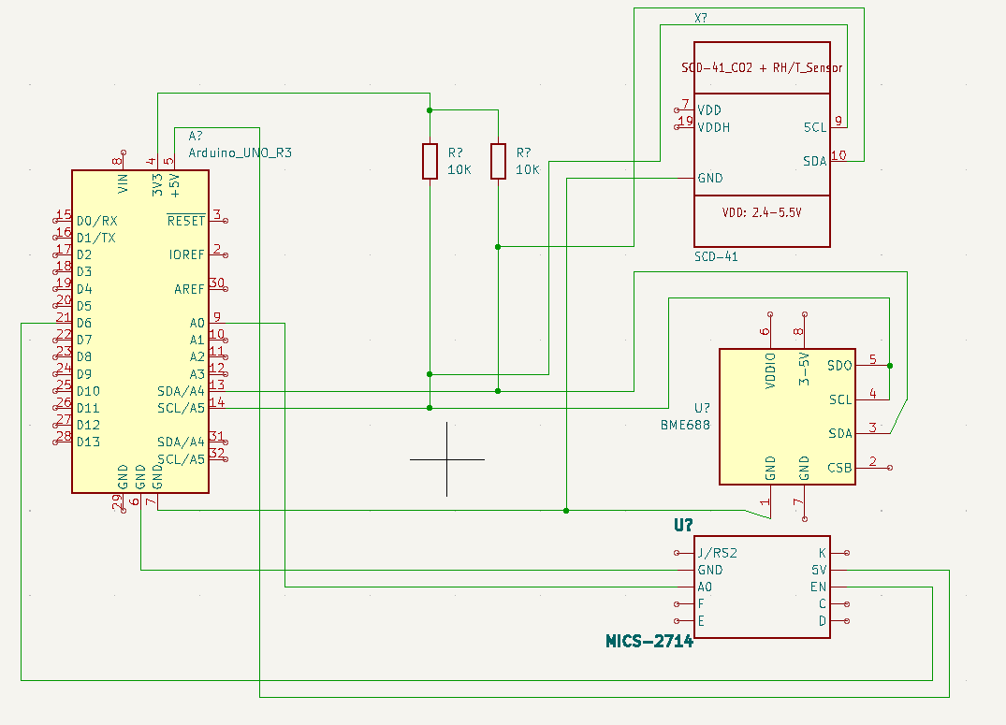
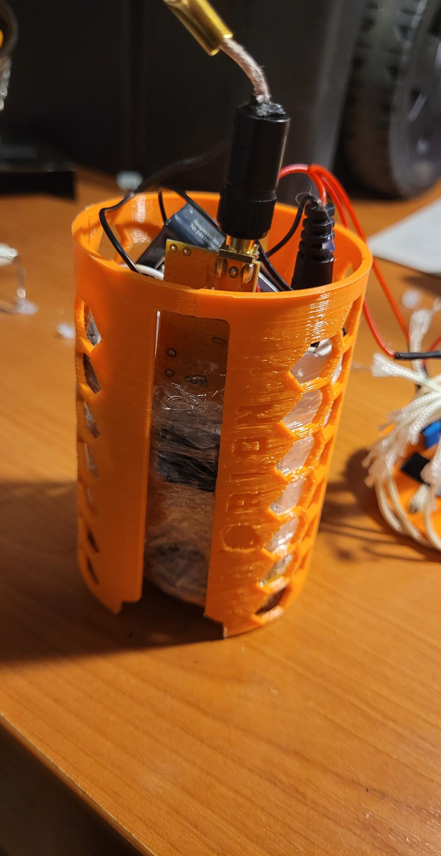
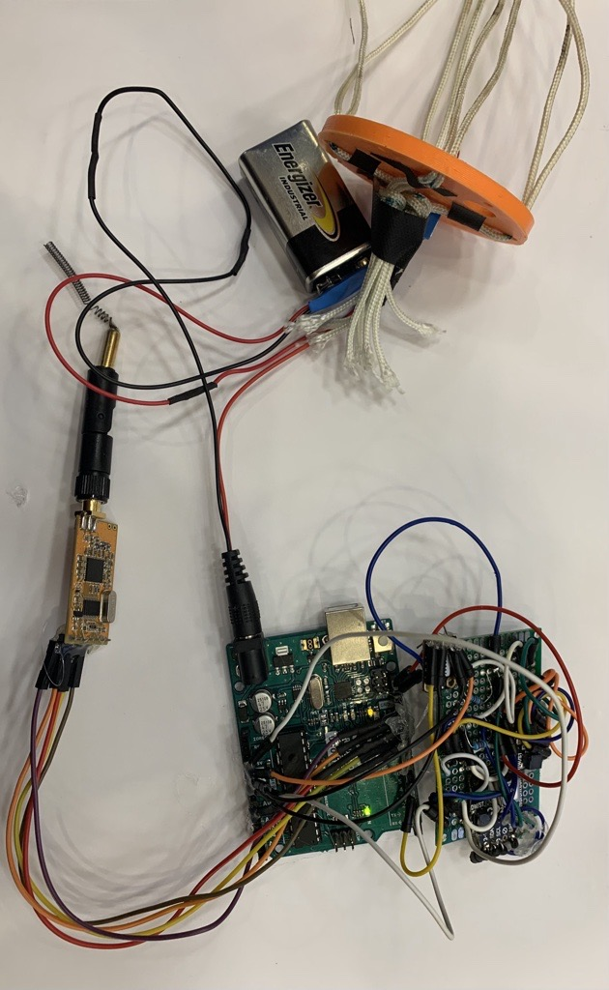
ELECTRONICS

Slide 7
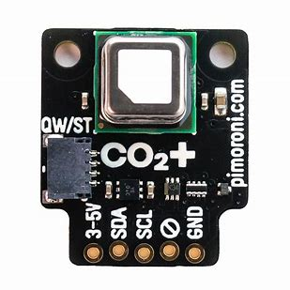
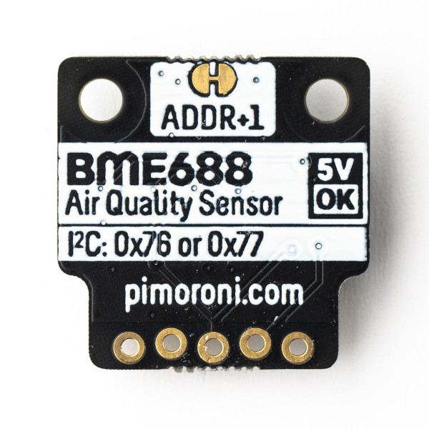
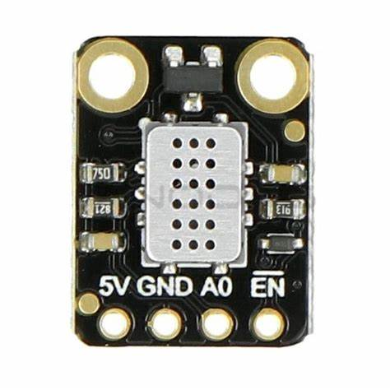
SENSORS
SCD41 Sensor
Carbon-dioxide
BME688 Sensor
P.A.T.H. and Volatile Organic Compounds
MICS2714 Sensor
Nitrogen Dioxide

Slide 8
ELECTRONICS

Slide 9
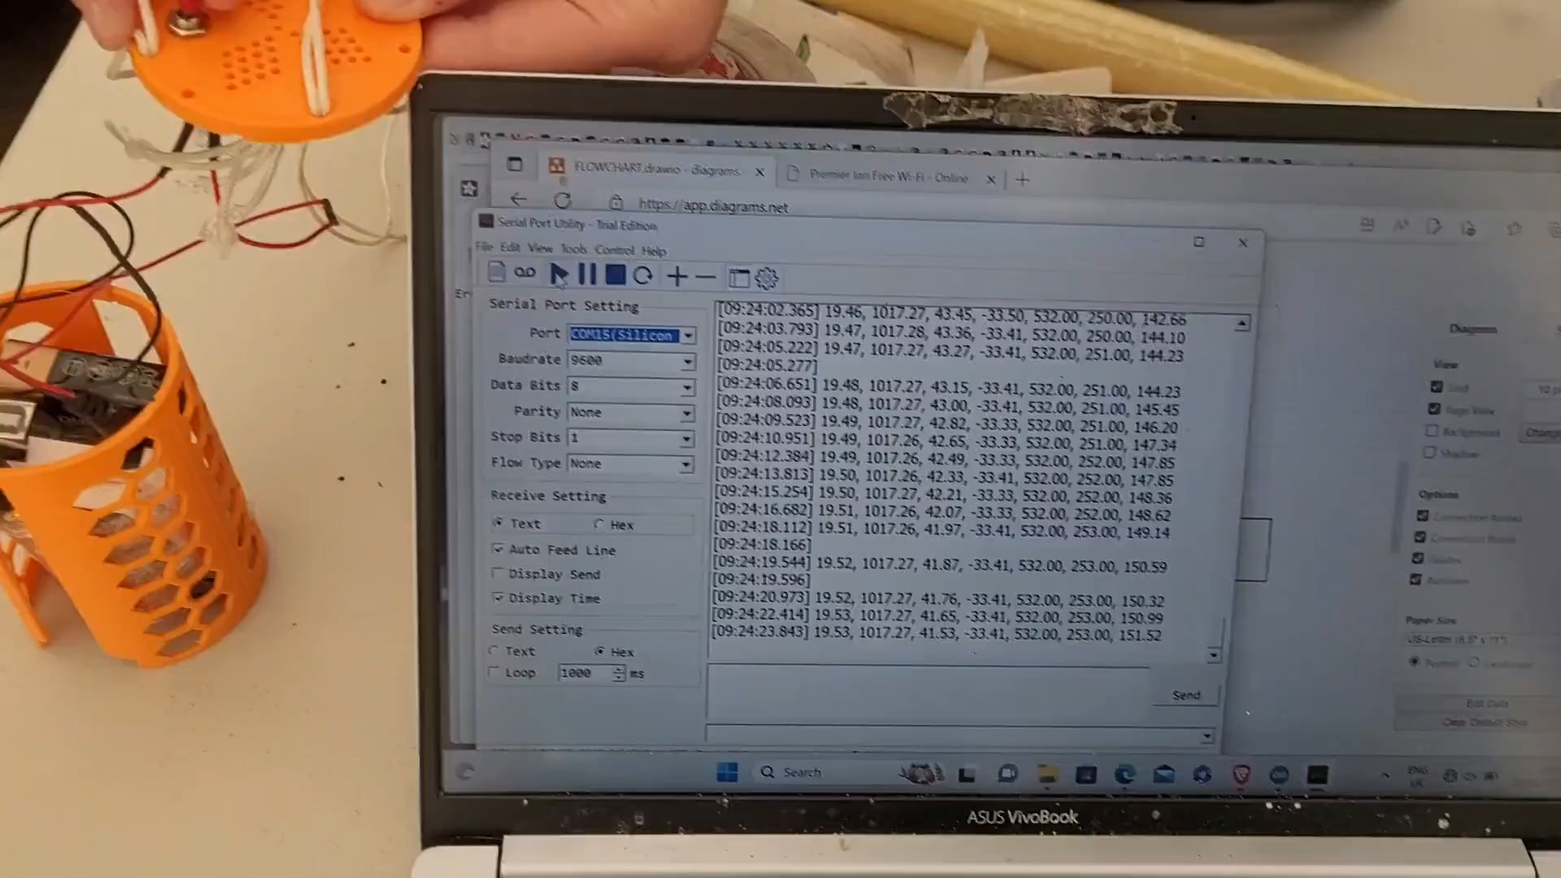
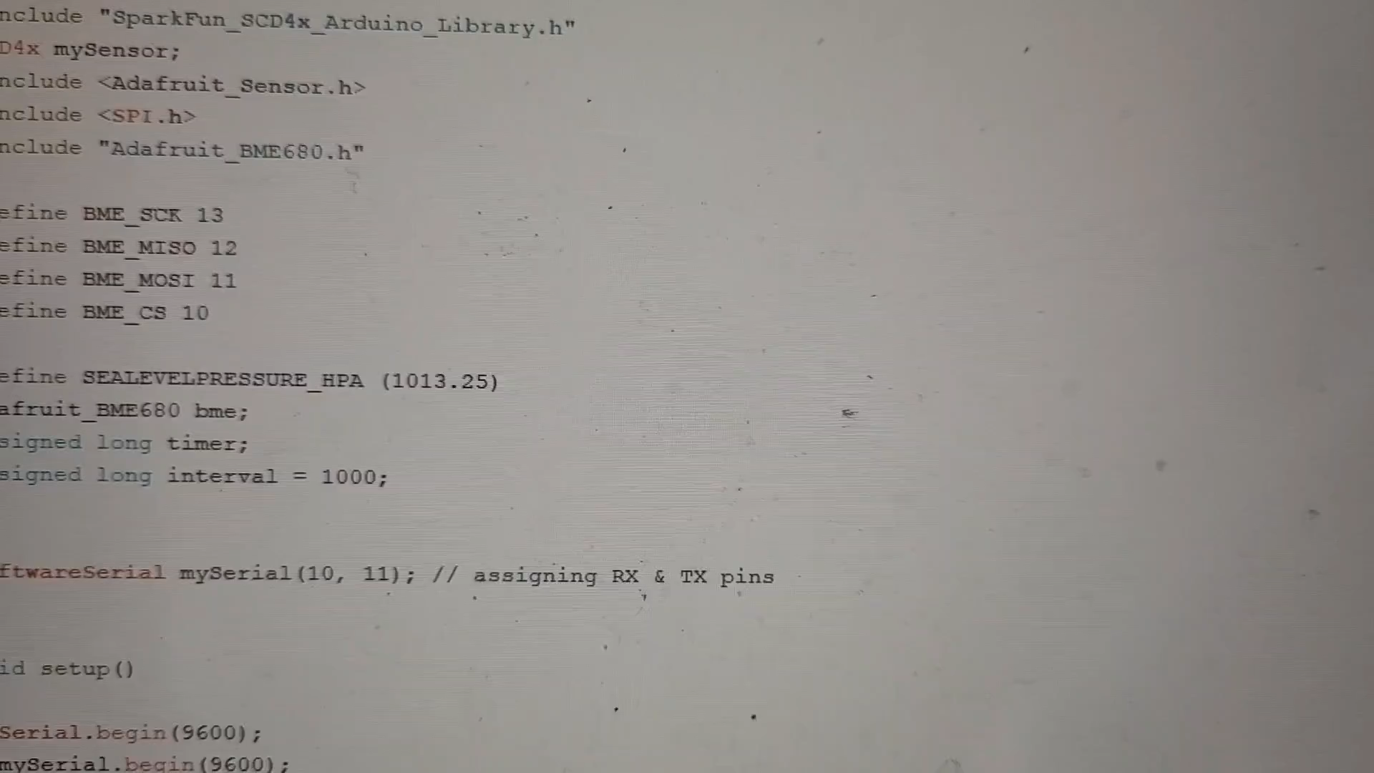
DEMONSTRATIONS

Slide 10

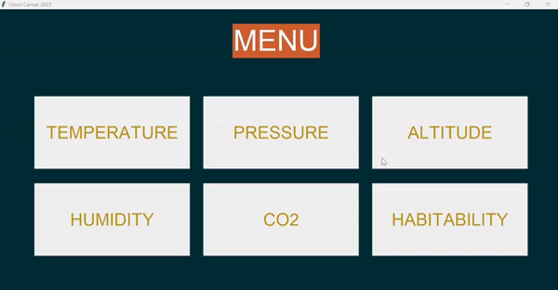
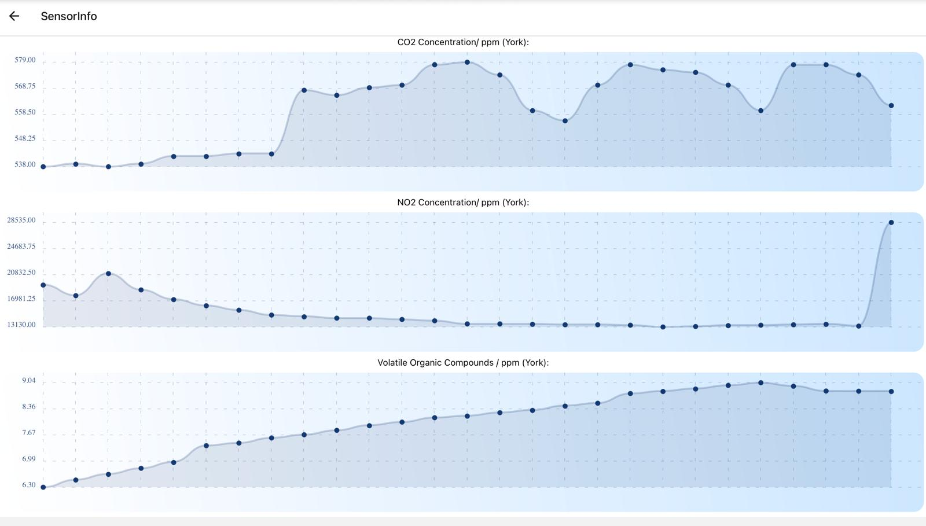
APP & GUI
Array of all the data from CVS file
For Loop: for i in array take index from 0-3 and add to a corresponding list
Each corresponding list now has data for each variable (temp, pressure, humidity, altitude)
Matplotlib Function creates plot of each variable by plotting the relevant data points
This is formatted into a function which corresponds to a button on the GUI
Notes:
Using python we created a GUI and implemented matplotlib to create animated graphs which show how the data progresses over time.
The values of the csv file containing our experimental data is indexed into arrays - the mean is then calculated to account for noise - and these are passed through the habitability function.
If the mean values are in accordance with the parameters we’ve set - the function returns habitable. For example, one of our parameters is the Armstrong limit (18,000m) above which the altitude is too high to support human life.
We also created a mobile app which displays our graphs, along with key data about them such as the mean and range.
Furthermore, it includes side by side comparisons of CO2 concentrations in York, Chelmsford and London.
The app was created using java script and react native and supports iOS, android and web usage. With further development the app could be adapted to act as a platform for cansat teams across the country to share and use data - increasing the sophistication and scope of future projects.
This app could also be shared with the general public, in an effort to make data on air quality more accessible.

Slide 11
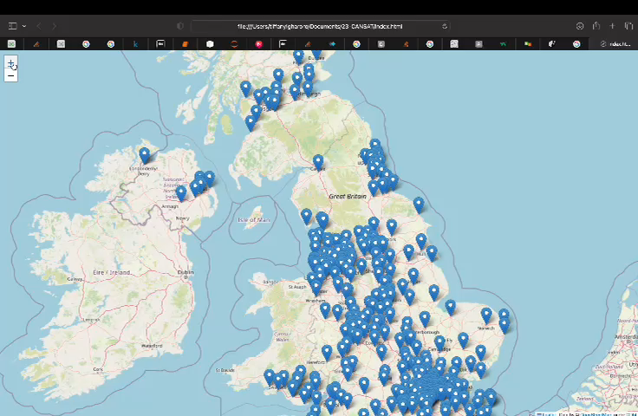
DATA ANALYSIS
Mean CO₂ (ppm):
York = 561.7
Chelmsford = 545
Southwark = 740
York mean P.A.T.H. data:
Pressure = 1021 hPa
Altitude = 12m
Temperature = 11.4ºC
Humidity = 44.5%
Notes:
Using the data we collected over the course of the project we compared CO2 concentrations of different locations. Given that CO2 concentrations correlate with population density we created a python program to predict CO2 levels across the country using the world population review data set.
This is done by comparing the population of a city or town in the UK, with that of York, Southwark and Chelmsford and then determining which of the 3 is closest.
Then the CO2 concentration of the closest area is multiplied by the percentage difference in population (of the town and our recorded region) - this extrapolation is then available to view on a world map and makes up our predicted CO2 values.
While there is a lack of data to compare our predictions to; we found that the program predicted CO2 levels in York to be 568ppm and our mean recorded value was 561ppm proving that this particular prediction was accurate.
has context menuComposeParagraph

Slide 12
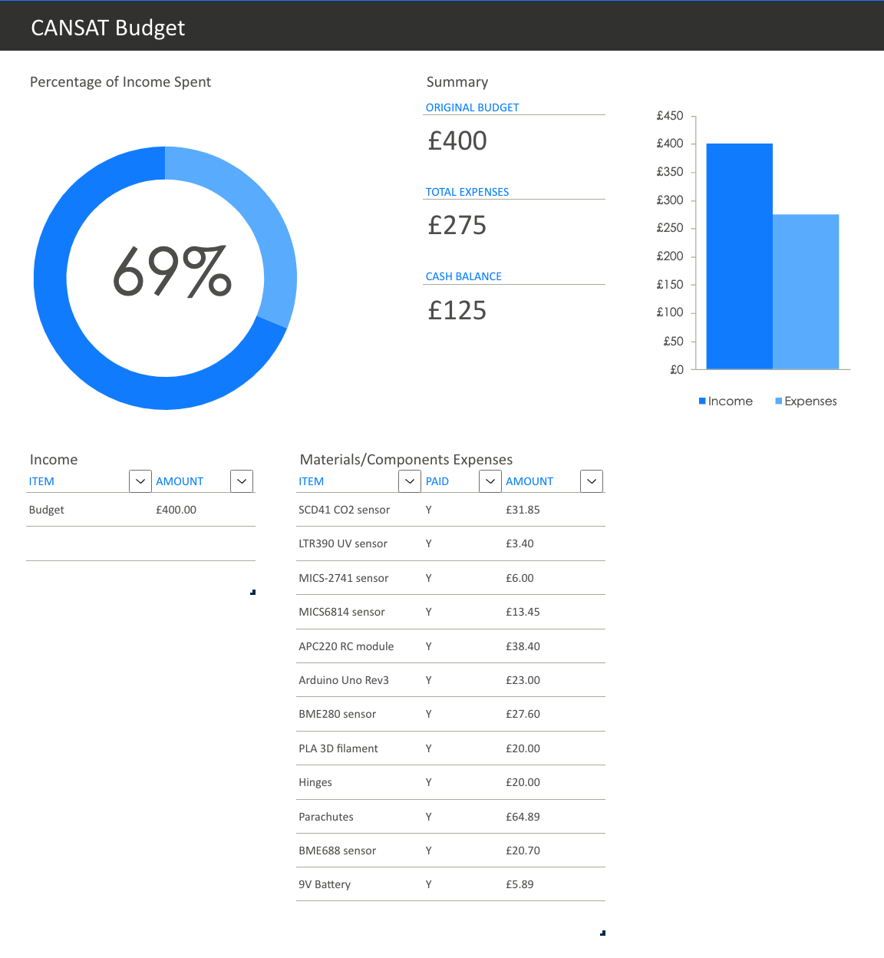
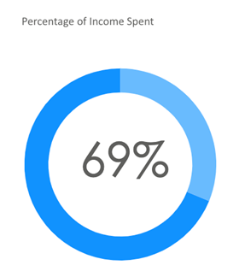
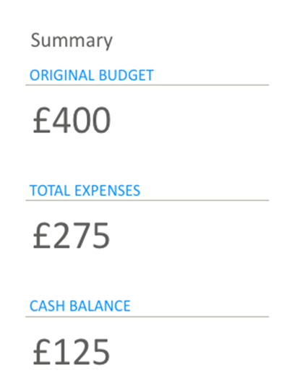
BUDGETING
Notes:
As head of marketing and finance I used my accounting skills to develop a comprehensible spreadsheet as shown above, so that we could stay on track with our financial decisions, after securing funding from our head.

Slide 13

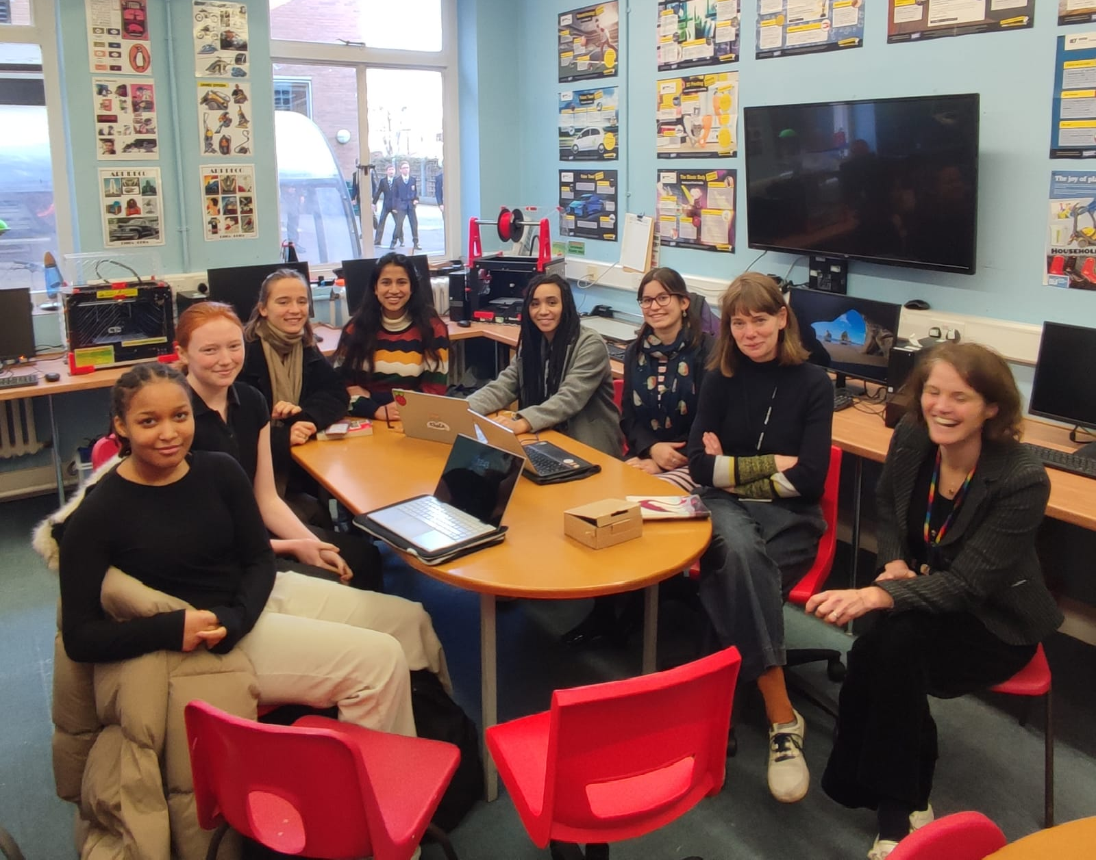
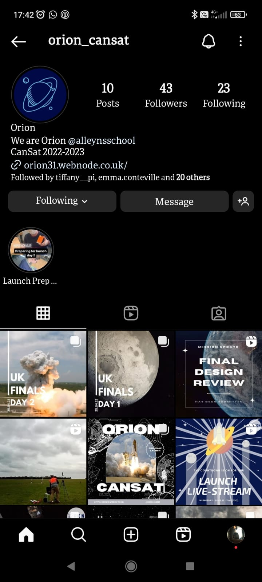
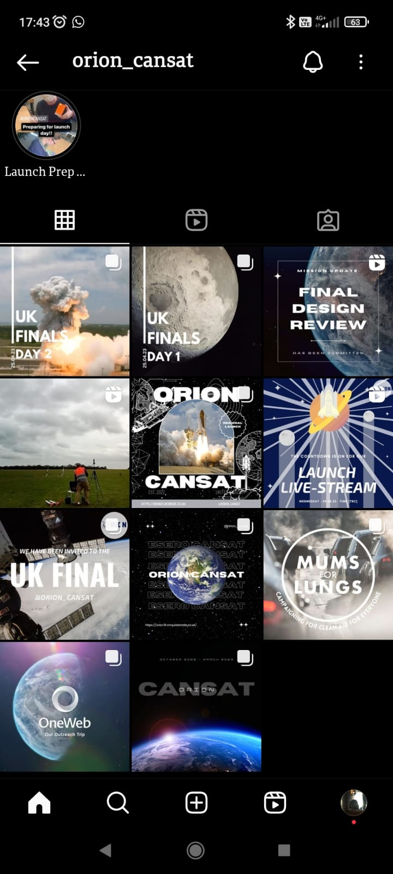

OUTREACH
OUTREACH
orion31.webnode.co.uk
Notes:
We are using our CanSat to have a widespread positive change on our community. We have made hoodies, an Instagram account and hosted talks and assemblies.At the start of the project we organised a trip to the satellite company OneWeb who gave us invaluable advice. As sustainability advocates, we have partnered with Mums for Lungs, a non-profit organisation which campaigns for cleaner air around schools, to measure levels of air pollution in our local area. We are organising a program for primary school students in which they would create their own nitrous oxide and carbon dioxide sensors, providing local schools with the data they need to aid their campaigns for cleaner air. This not only helps educate young children about the dangers of air pollution but also cultivates both creative and scientific skills. We are working closely with our Environment Society, and have published our work in our school’s eco-newsletter. Through our affiliation with Mums for Lungs, we have been given the opportunity to present our project on Clean Air Day to local MPs, councillors and national news reporters. To spread awareness further we live-streamed and posted to our website both our launches which successfully inspired 4 teams from our school to take part next year.

Slide 14
